Slide 1
多面体を裏返す
伊藤仁一(椙山女学園大学)
堀尾直史氏との共同研究
Notes:
I appreciate to the organizers for giving me a chance to have a presentation here.
My name is Naofumi Horio. I am a junior high school mathematics’ teacher, but now a graduate student of Kumamoto University Graduate School of Education.

Slide 2
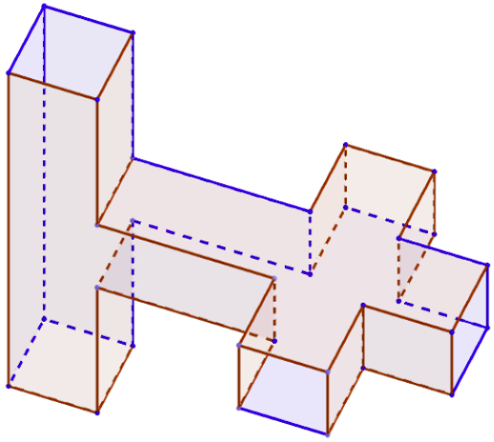
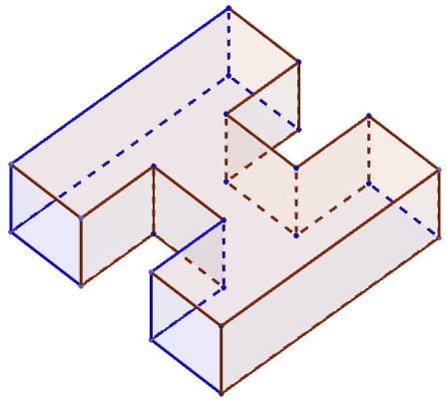
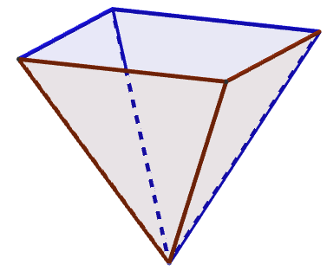
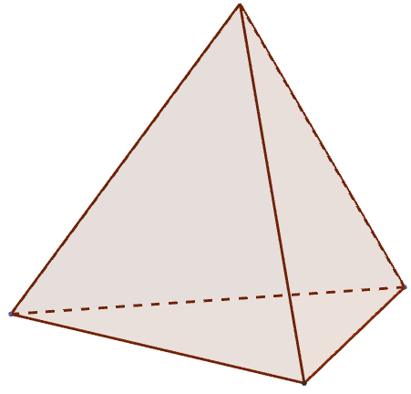
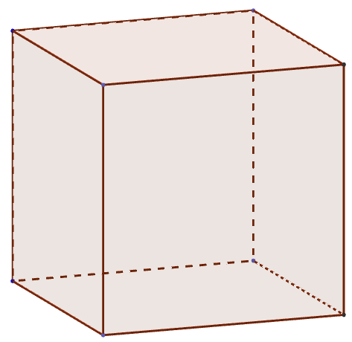
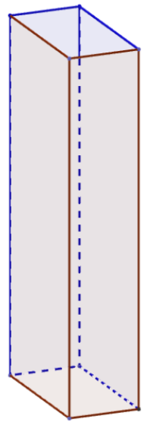
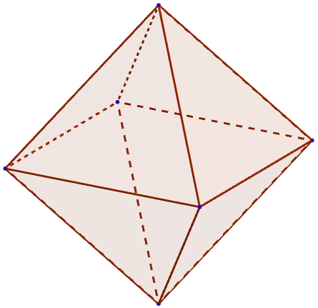
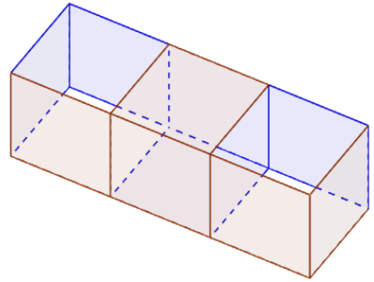
Reversible?
Notes:
Recently Hiroshi Maehara considered the reversibility of several polyhedral surfaces in his paper.
In this talk we continue his research and announce several results.
Before that, we have to stand for his theorems.
Here we define the word “Reversible”. As these paper models show, if a polyhedral surface is inside out of itself, we call it reversible.

Slide 3
Hiroshi Maehara defined an origami deformation of a polyhedral surface M in R³ as the existence of continuous motion f_{t}: M $→$ R³ (0≤t≤1) of M such that
f₀ is a inclusion map,
for each face of M, the induced motion of the face is a rigid motion,
two faces may touch or overlap during the motion, but they never go through each other,
the motion is not a rigid motion of the whole M.
He also called a polyhedral surface subdivision-reversible (shortly s-reversible). He proved several results and many interesting problems.
Reference [1]
H.Maehara: Reversing a polyhedral surface by origami-deformation, European Journal of Combinatorics 31 (2010), 1171-1180
Notes:
Maehara defined an origami-deformation of a polyhedral surface as shown.
He showed that every rectangular tube and some polyhedra can be subdivided so that it becomes reversible. We call it s-reversible.

Slide 4
Maehara’s theorem
Every rectangular tube is s-reversible.
（[1] Th.3）

Slide 5
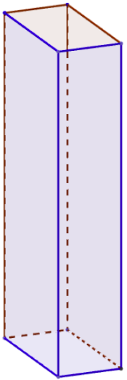
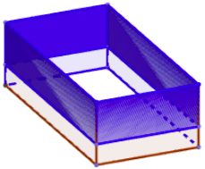
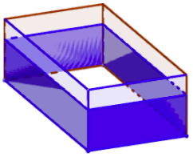
Every rectangular tube is s-reversible.
（[1] Th.3）

Slide 6
Maehara’s theorem
The surface obtained from a s-reversible polyhedral surface M by applying a tube-attachment operation is also s-reversible.
（[1] Th.4）

Slide 7
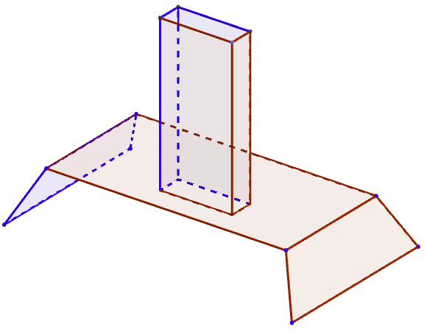
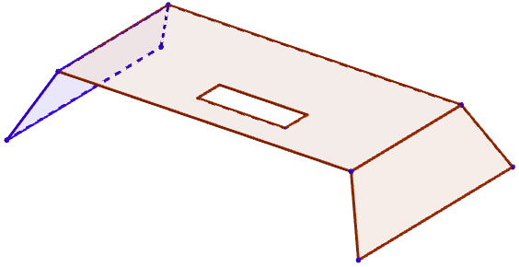
a tube-attachment operation

Slide 8
The surface obtained from a s-reversible polyhedral surface M by applying a tube-attachment operation is also s-reversible. （[1] Th.4）

Slide 9
If polyhedral surface have not the vertex of convex point and have subdivided origami-deformation to a tube, then it has a possibility to be s-reversible.

Slide 10
s-reversible！

Slide 11
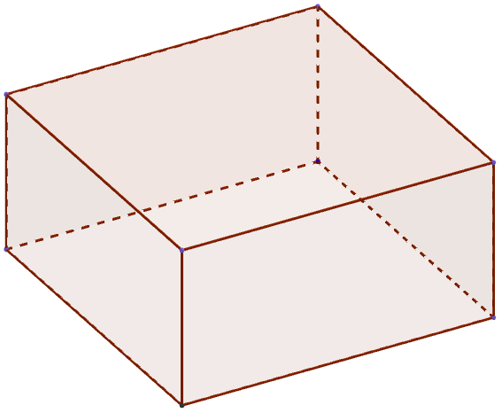
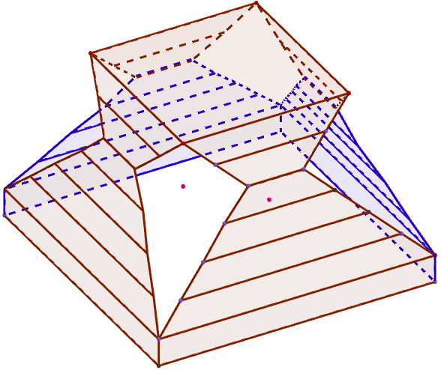
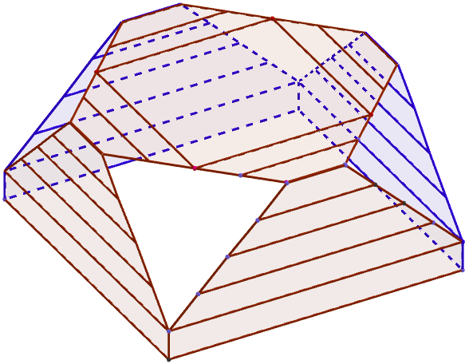
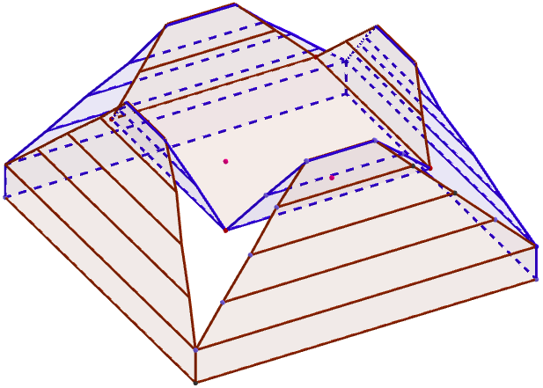
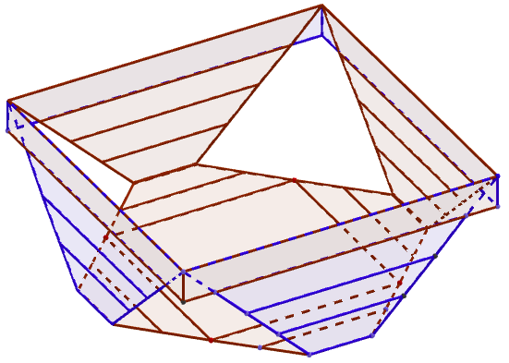
s-reversible！

Slide 12
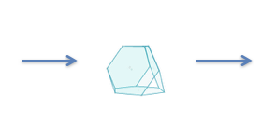
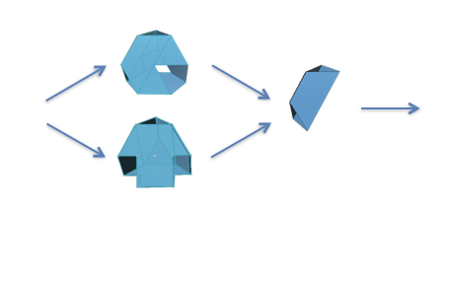
Regular tetrahedron
Not
s-reversible
?
Cutting off the convex points
s-reversible
or
ets
Notes:
Now, we try to reverse regular polyhedras with holes.

Slide 13
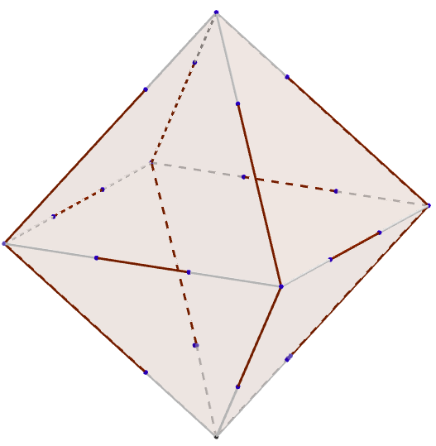
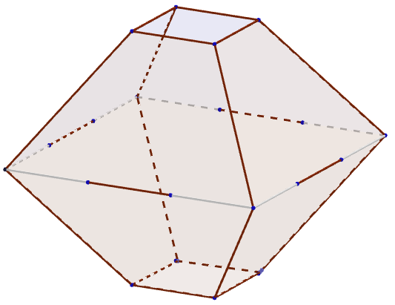
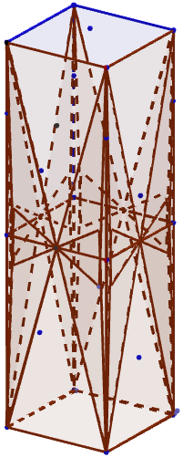
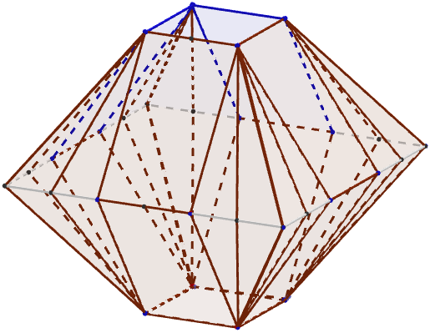
Regular octahedron
Cutting off one convex vertex and the opposite vertex
Cutting along edges around the other vertices
Make pleats and fold in, leaving the part to become the side of the tube.
s-reversible

Slide 14
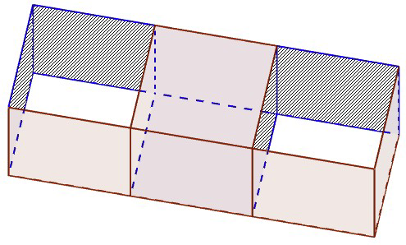
reverse this polyhedral surface
XC₄ : a 3 times extended cube with 4 square holes
This is not a tube. At first we need to deform it to a tube.

Slide 15
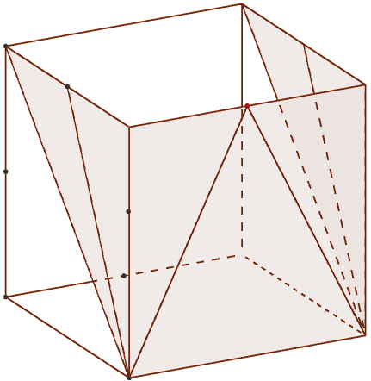
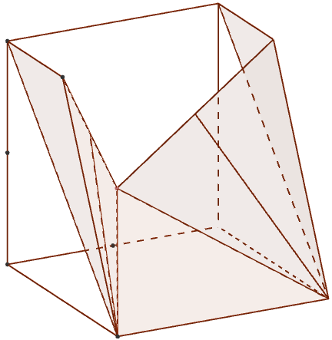
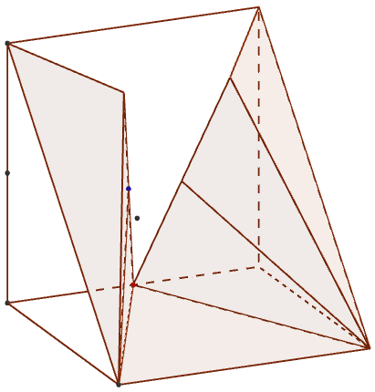
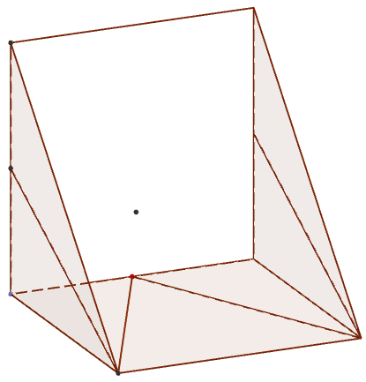
New operation：semi-flattening-operation

Slide 16
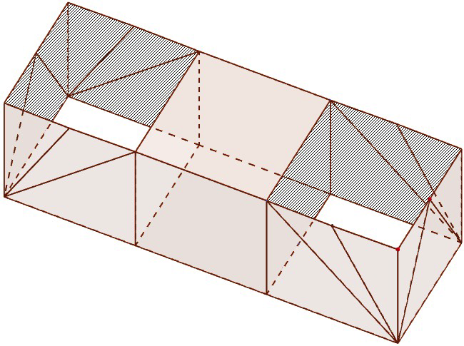
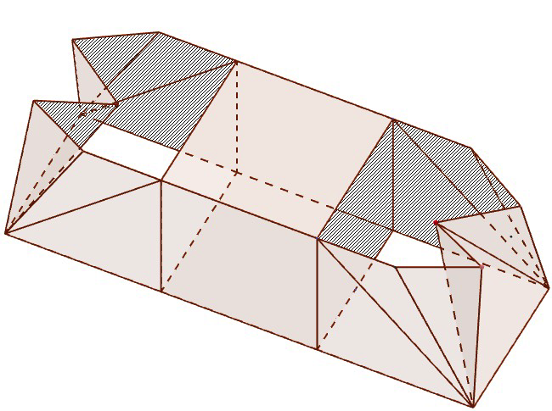
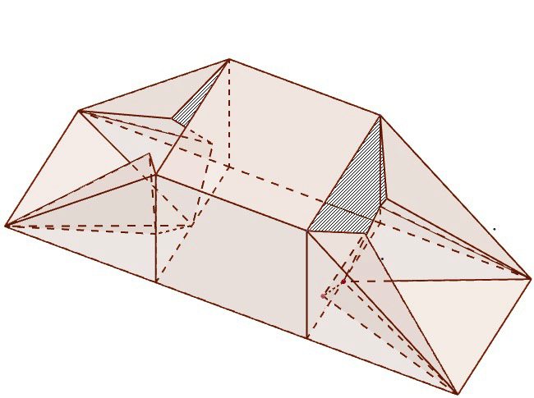
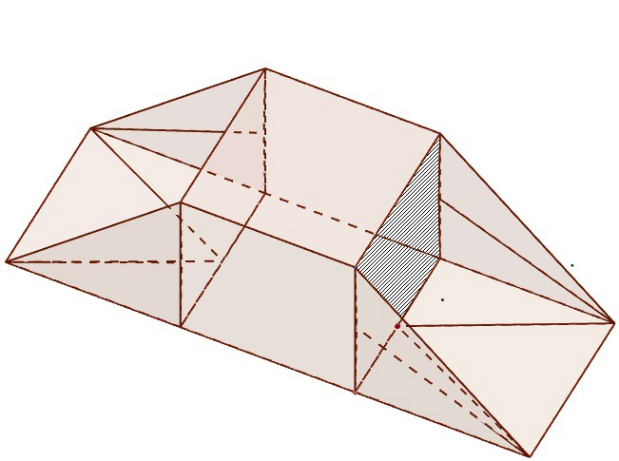
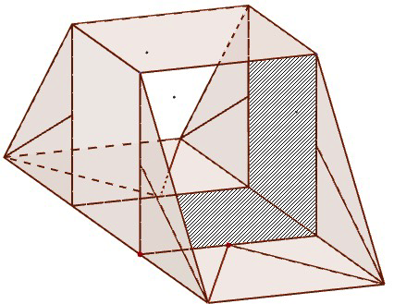
Applying semi-flattering operation to a XC₄.
Now a XC₄ deforms to a tube.

Slide 17
Remark
If we can deform a polyhedral surface into a rectangular tube, we can apply Maehara's method, but it does not mean reversing can be completed.

Slide 18
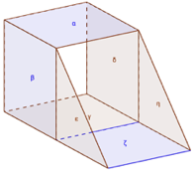
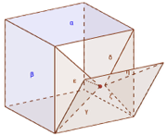
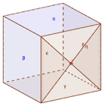
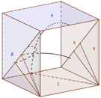
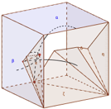
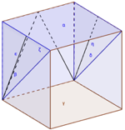
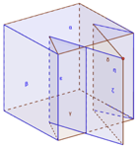
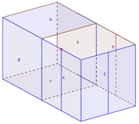
After the Maehara’s method
Only one side is shown. Red are front surfaces and blue are back surfaces.
A XC₄ is s-reversible.

Slide 19
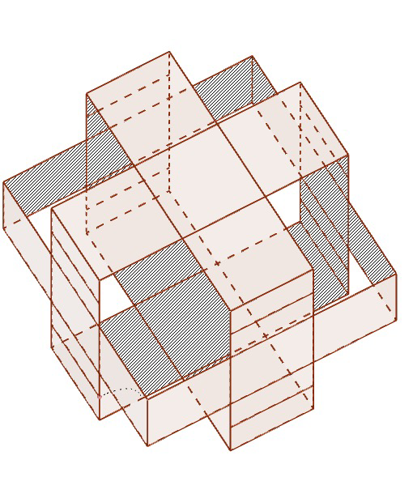
reverse this polyhedral surface
C₈ : a surface of cube with 8 holes
This is not a tube. At first we need to deform it to a tube.

Slide 20
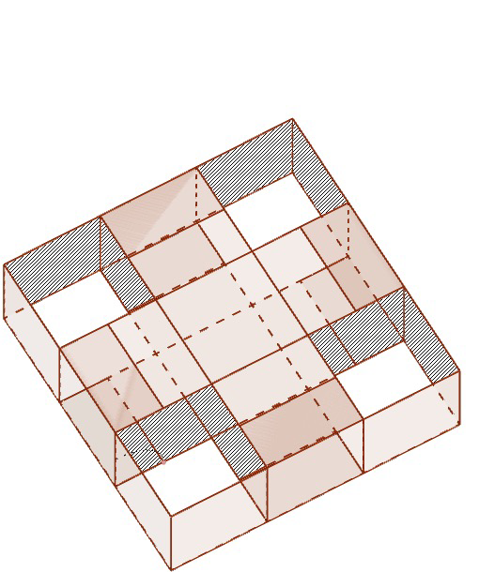
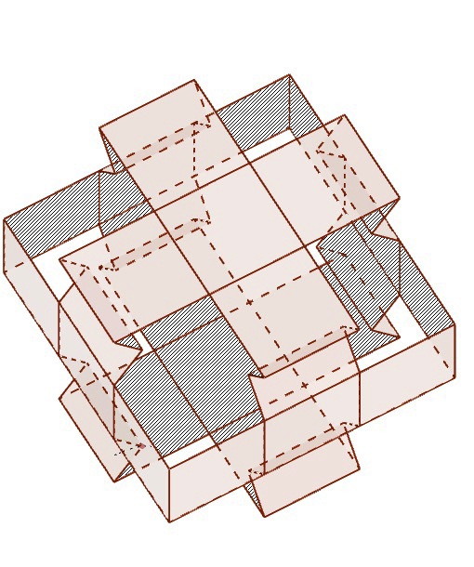
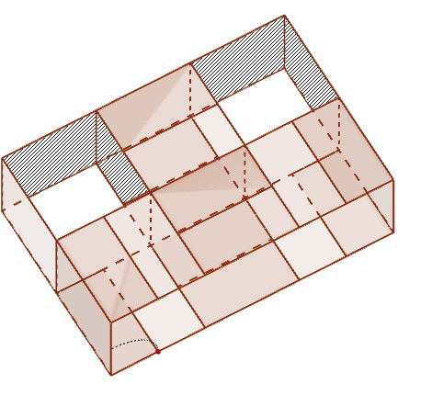
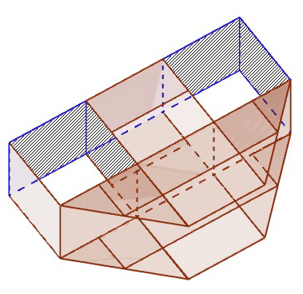
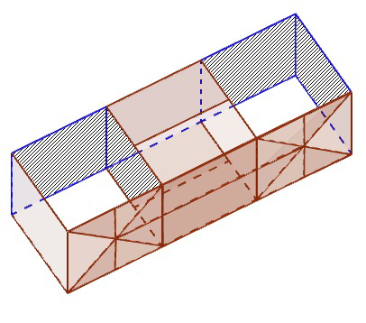
Applying semi-flattering operation to a C₈.
Now a C₈ deforms to a XC₄, then deforms to a tube. Even taking into account the folded faces, this is s-reversible.

Slide 21
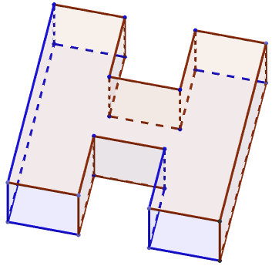
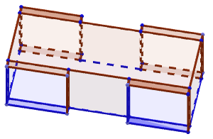
reverse this polyhedral surface
H₄ : a H-shaped polyhedral surface with 4 holes
We cannot deform this polyhedral surface to a XC₄.
No matter how hard we try to shorten the hights of the tubes, we cannot make the hights zero.
We need another solution.

Slide 22
Reversing a H₄.
Only one side is shown. Red are front surfaces and blue are back surfaces.
Now a H₄ is s-reversible.

Slide 23
Considering further
cubical-tube-unit-attachment operation
Consider polyhedral surfaces made of unit cubes on the grid points. Take a initial unit cube. Attach the cubical-tube-unit on some unit cube of a previous polyhedral surface such that the attaching unit-tube does not overlap the other unit cubes of the previous polyhedral surface, and remove the attached face of the previous polyhedral surface.

Slide 24
Theorem
Every polyhedral surface made of cubical-tube-unit-attachment operation is s-reversible.

Slide 25
double flexatube
double flexatube and its development
Def.1
From an extended box 1×1×2, remove a pair of opposite faces, and crease remaining four face as shown the above figure, which is consists of 96 right isosceles triangles and 16 squares.
Th.1
The above double flexatube is reversible. Moreover the folded layers do not sandwiched another layer.

Slide 26
Cube (Cutting face)

Slide 28
Cube with (green) slits (only on its edges)

Slide 29
a cubical surface with slits whose length ４＋ε
Th. 2
The above cubical surface with slits is reversible after adequate subdivisions with respect to doubleflexatube .

Slide 30
定義：正方形の紙をorigami-deformation により折ってその周の全てを平面に接させることができる立体を「折り紙テント」と呼ぶ．

Slide 31
$$t≈0.219255$$
$$V≈0.0878266$$

